Slide 1
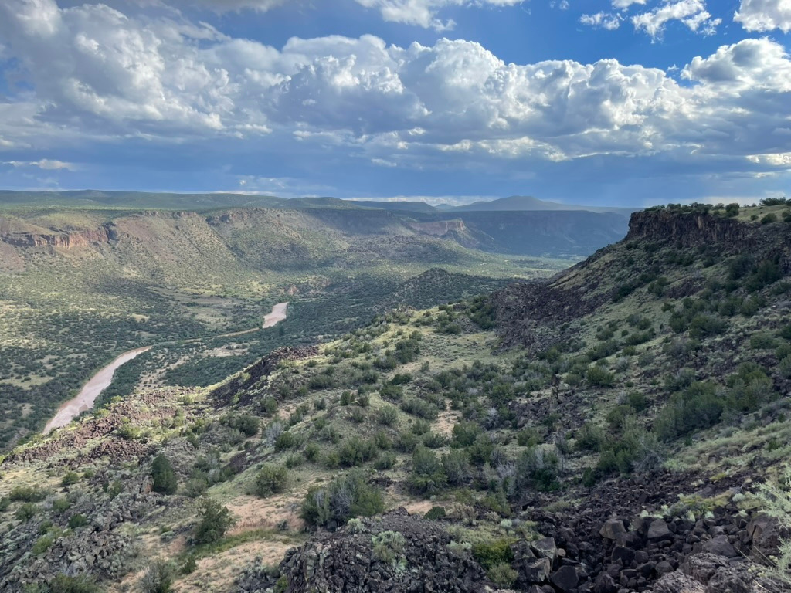
Enabling Efficient Computational Modeling at LANL
DevOps, Code Maintenance, and Innovation in dfnWorks, FEHM, Amanzi/ATS, and Watershed Workflow

Slide 2
01 | Introduction
02 | Tools and Software
03 | Project Examples
04 | Contributions to E-13
05 | Conclusion
WHAT'S IN STORE
Agenda

Slide 3
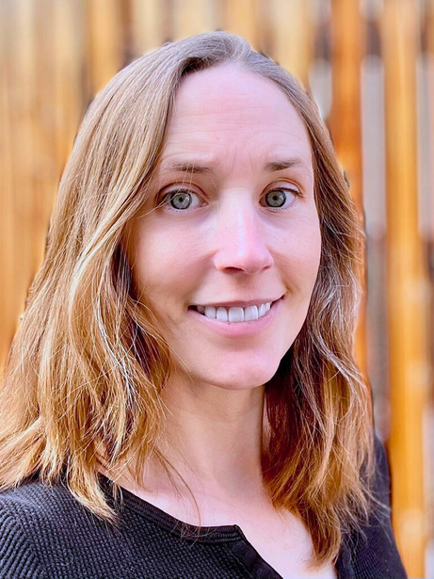
Erica Hinrichs
Software Development/Maintenance
DevOps and Git repository Management
Linux Server Administration and Development
Website Development and Maintenance
General User Support for Linux, Mac, and Windows
Mesh Generation, model simulation
Broad background that includes mechanical as well as computer and software engineering
Notes:
ees16 and T5 division for last 2 years
hired as post-masters but working as RT and software engineer
associated in pre-engineering
bachelors in Information and communication technologies
master of engineering in information technology

Slide 4
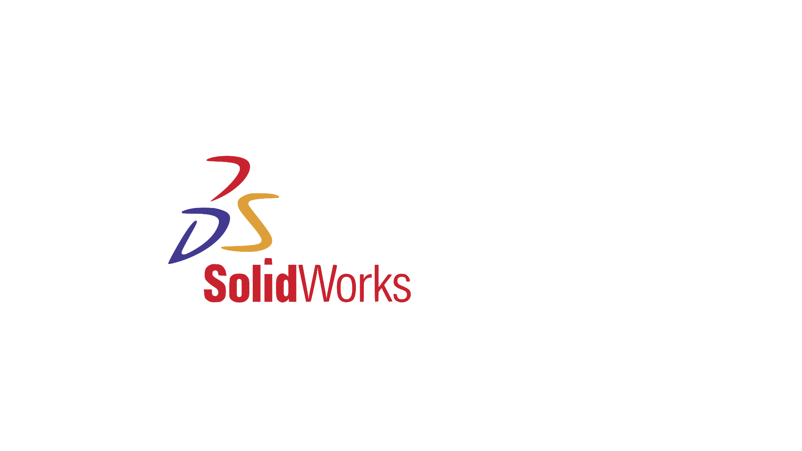
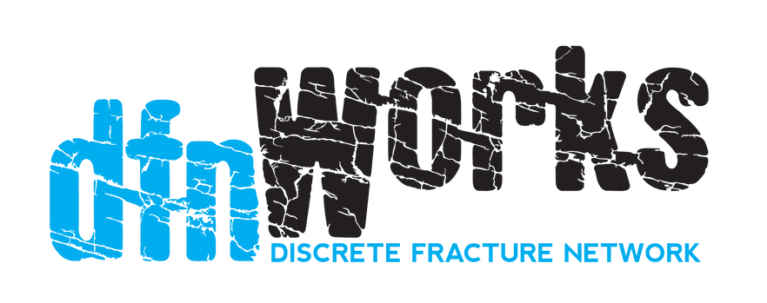






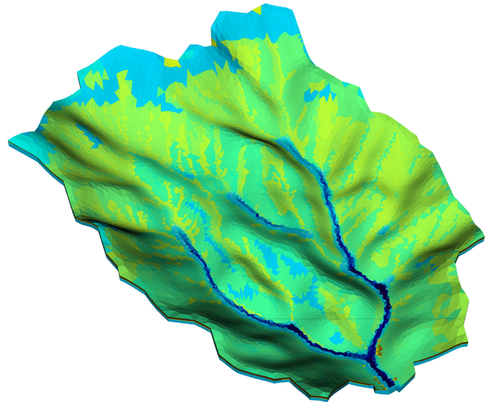





Tools
Software
Tools
Watershed Workflow
LaGriT
Notes:
Not exhaustive, but some of the software that I actively maintain and develop, and some frequently used tools

Slide 5

Project Examples

Slide 6
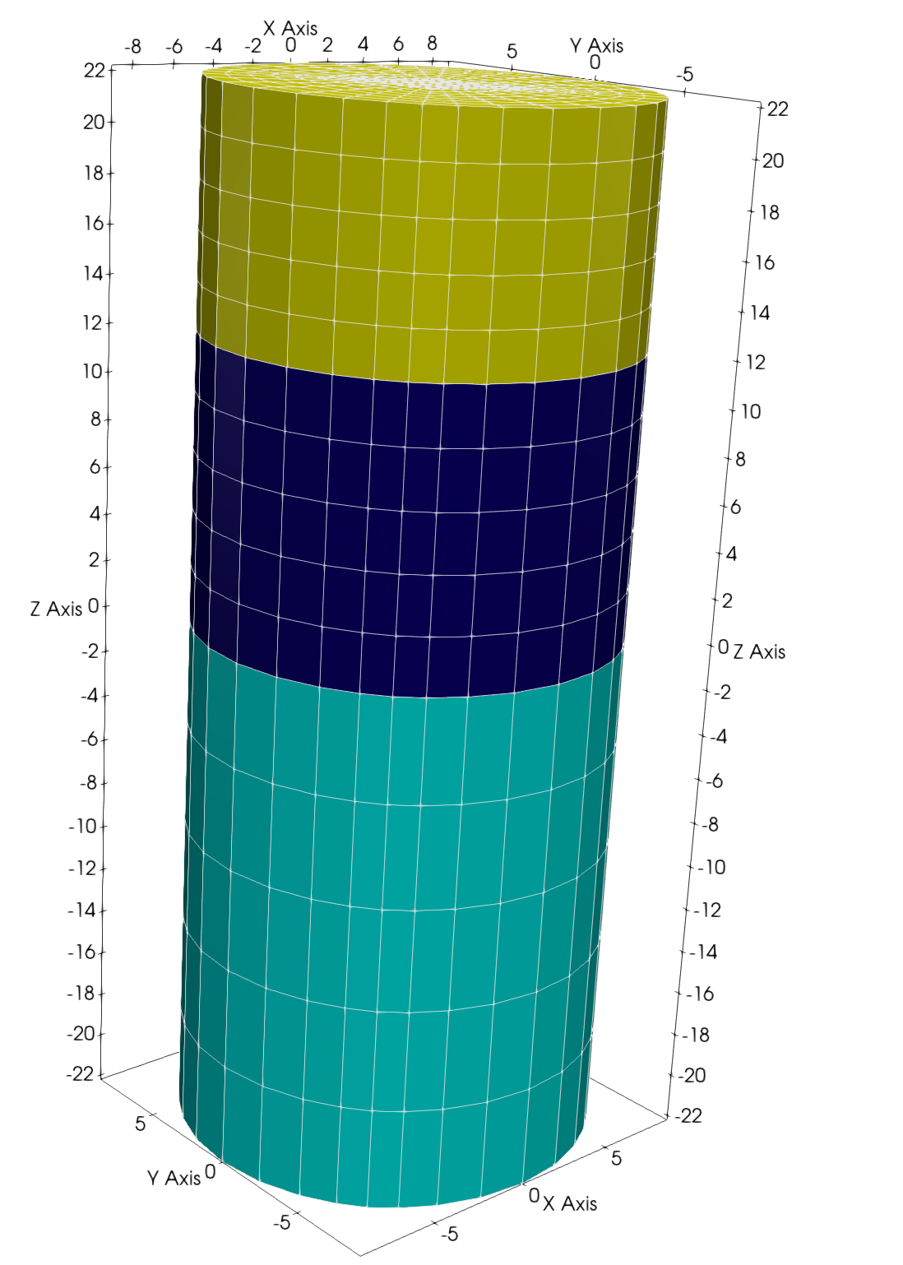
Project 1:
Lagrit
LOS ALAMOS GRID TOOLBOX
Library of user callable tools that provide mesh generation, mesh optimization and dynamic mesh maintenance in two and three dimensions. LaGriT is used for a variety of geology and geophysics modeling applications including porous flow and transport model construction, finite element modeling of stress/strain in crustal fault systems, seismology, discrete fracture networks, asteroids and hydrothermal systems.

Slide 7
Challenges
Process
Legacy code
Complicated Installation process
Outdated and missing dependencies
Issues with different Operating and build systems
Outdated documentation
New release needed
Created User Tutorials
Converted legacy code from Python2 to Python3 and updated python wrappers for older fortran code
Updated Makefiles and scripts for use with various Operating systems (Linux, Mac (M-chip and Intel))
Updated Makefiles and scripts for use with various Build systems (Macports and Homebrew)
Updated the required dependencies and packages for Exodus
Updated documentation and rebuild User Guide Website https://lanl.github.io/LaGriT/
Using github, collaborated with developers to create latest release on development branches. Merged to master when ready, generated documentation for website, created docker container to help ensure a stable environment for users
Created a series of new user tutorials

Slide 8
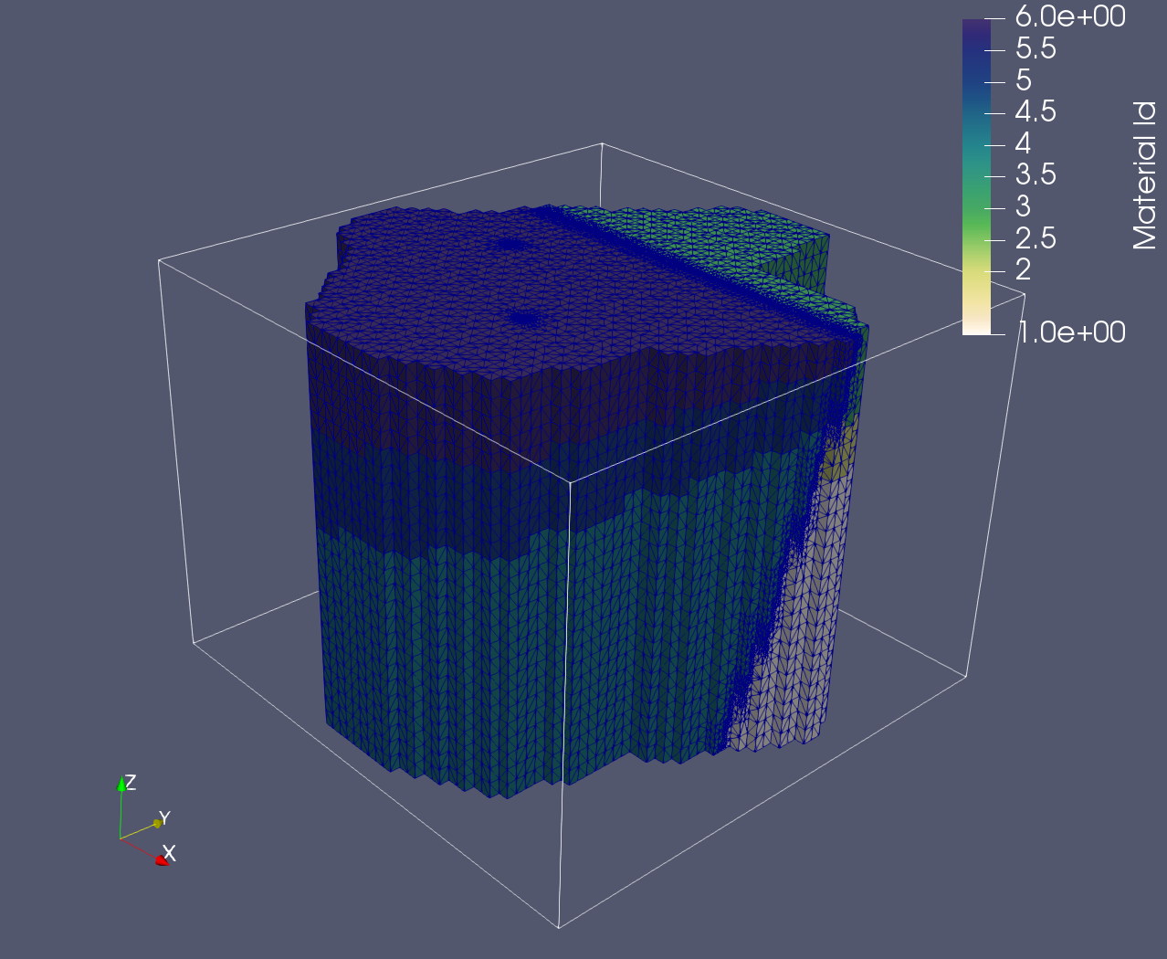
LAGRIT
Results
Simplified installation on Mac and Linux making it easier for new users to get started
Resolved dependency issues that were preventing users from accessing certain advanced features
Updated legacy code to be more consistent across the repository and allow access to newer python libraries
Created detailed documentation and tutorials to help new users get started and become more familiar with the tools
Successfully released version 3.3.3
Image shows a geographical model with a fracture and two well bores. It was created using LaGriT and a tetrahedral mesh and contains layers with multiple different materials.

Slide 9
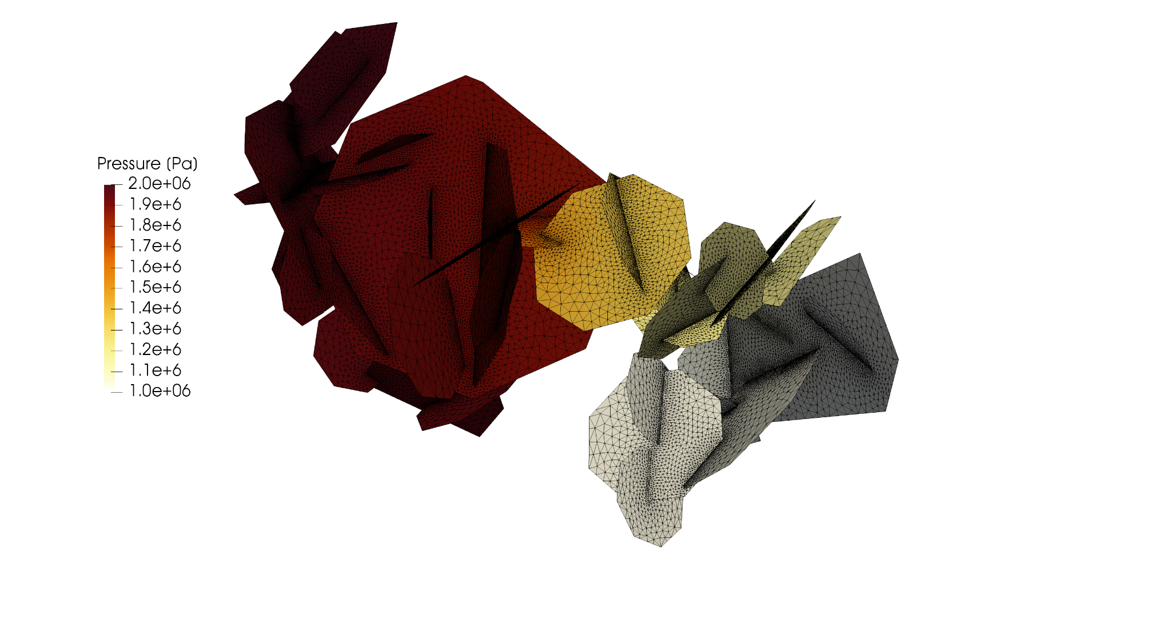
Project 2:
dfnWorks
DISCRETE FRACTURE NETWORK
dfnWorks is a parallelized computational suite to generate three-dimensional discrete fracture networks (DFN) and simulate flow and transport in fractured media at scales ranging from millimeters to kilometers.

Slide 10
Challenges
Process
Legacy code
Complicated Installation process
Outdated and missing dependencies
Lack of logging ability
Outdated or missing python wrappers for C++ code
Missing features
Outdated documentation
New release needed
Converted legacy code from C to C++ as well as Python2 to Python3
Simplified the file structure and installation process for dfnWorks by combining files when able and updating makefiles
Updated the required dependencies and packages
Added logging ability using C++ and header files
Updated python wrappers for C++ code
Added the Bingham distribution using C++ and python, created new computational code, created validation test for accuracy
Updated sphinx autodoc to automatically generate documentation for the user guide and website https://lanl.github.io/dfnWorks/intro.html
Using github, collaborated with developers to create latest release on development branches. Merged to master when ready, generated documentation for website, created docker container to help ensure a stable environment for users

Slide 11
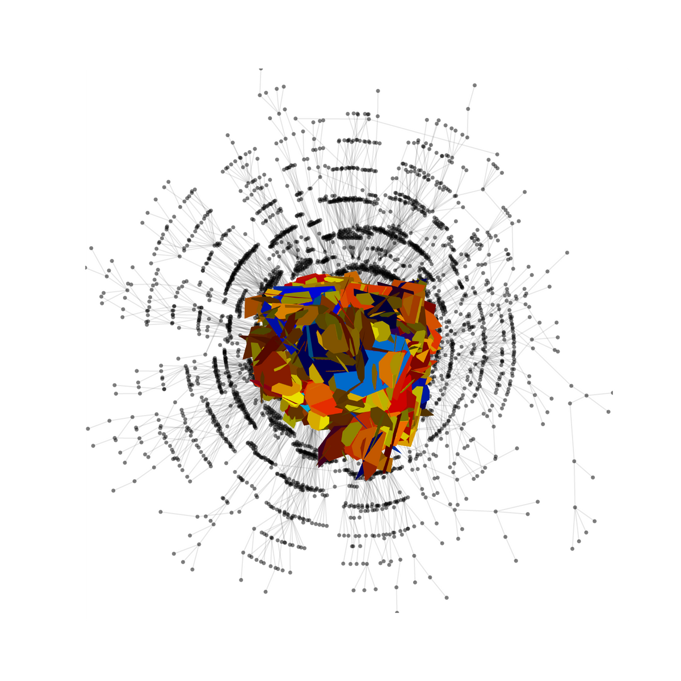
DFNWORKS
Results
Simplified installation process removing the need for a python wheel and instead using a toml file
Simplified file structure for installation
Resolved dependency issues
Updated legacy code to be more consistent across the repository and allow access to newer libraries
Created detailed documentation using sphinx autodoc to help new users get started and become more familiar with the tools
Added the Bingham distribution to dfnWorks
Image shows a discrete fracture network along with it’s graphical representation

Slide 12
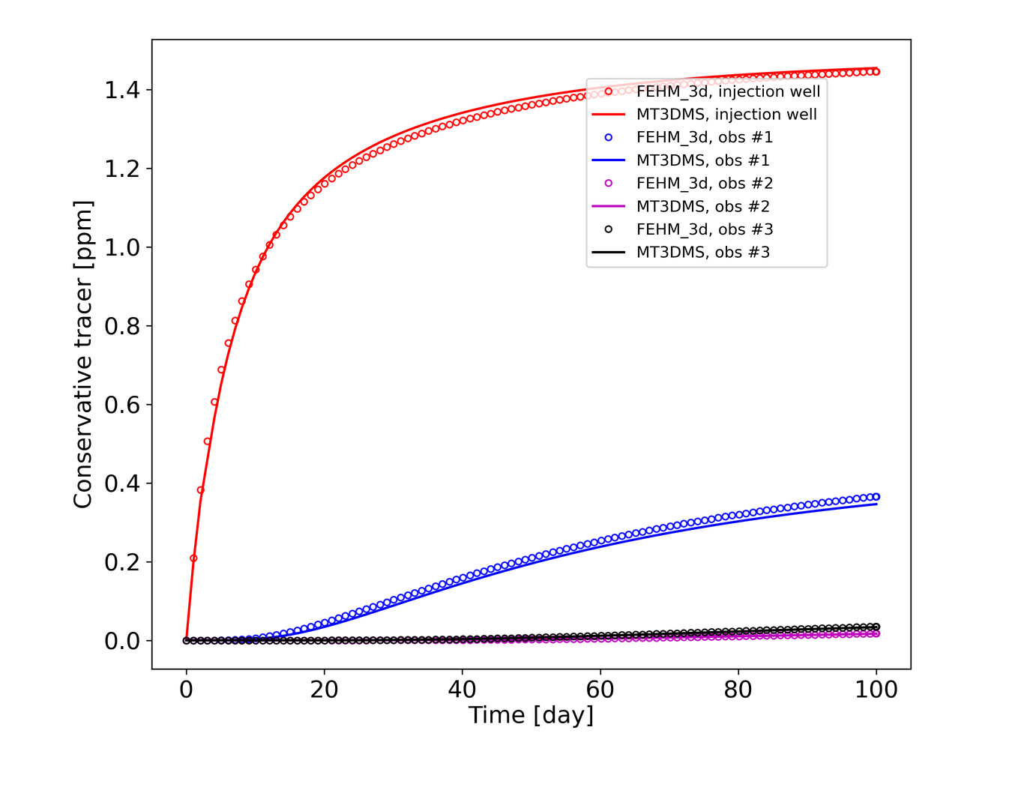
Project 3:
FEHM
FINITE ELEMENT HEAT & MASS TRANSFER
FEHM is used to simulate groundwater and contaminant flow and transport in deep and shallow, fractured and un-fractured porous media. FEHM has proved to be a valuable asset on a variety of projects of national interest including Environmental Remediation of the Nevada Test Site, the LANL Groundwater Protection Program, geologic CO2 sequestration, Enhanced Geothermal Energy (EGS) programs, Oil and Gas production, Nuclear Waste Isolation, and Arctic Permafrost.

Slide 13
Challenges
Process
Legacy code
Issues with the verification test suite
Operating system incompatibilities
Outdated documentation
New release needed
Lack of resources for new users
Modeling and Simulations
Converted legacy code including Fortran, Perl, C, and Python2
Created a new simplified test suite using python to allow for quick validation as well as provide working examples for developers and users to build from
Solved various operating system incompatibility issues including linux, mac (M-chips and Intel), and Windows
Updated documentation and created a totally overhauled user guide website https://lanl.github.io/FEHM/ using Jekyll and Github
Facilitated the development, testing, and deployment of major releases on Github
Facilitated the creation of tutorials and seminars for new FEHM users
Modeled and simulated the flow of water and Radon gas through non-fractured porous media with dual porosity and single permeability

Slide 14
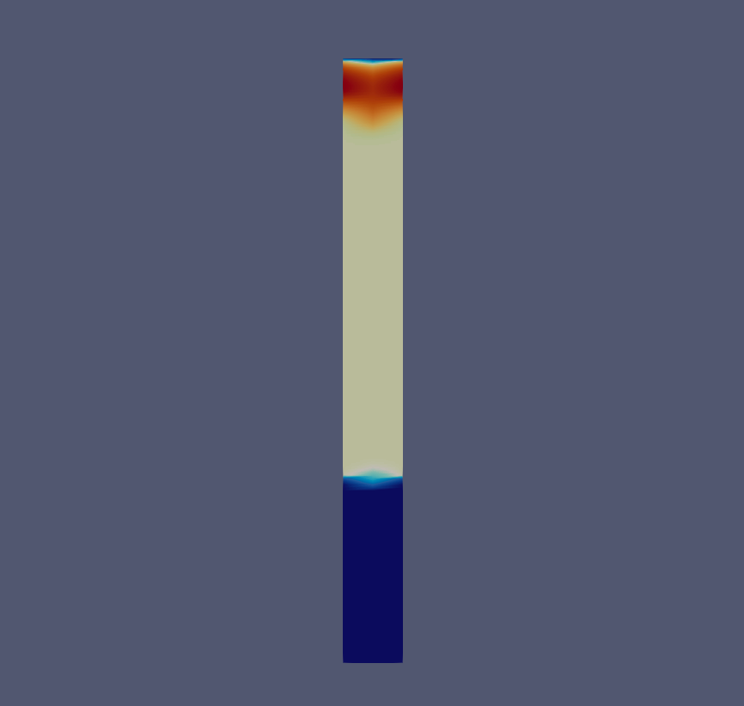
FEHM
Results
Updated legacy code to be more consistent across the repository and allow access to newer libraries
Created a new python-based test suite to validate tests more efficiently
Solved various Operating System issues that caused issues with reproducibility across multiple architectures
Updated user documentation, tutorials, and examples on a newly overhauled website
Image shows a slice of milling cover model. It has two layers with dual porosities and is modeling the flow of water down (visible as the red), as well as the transport of Rn222 from the base. It is created using FEHM and a newer feature called GDPM, or General Dual Porosity Model.

Slide 15
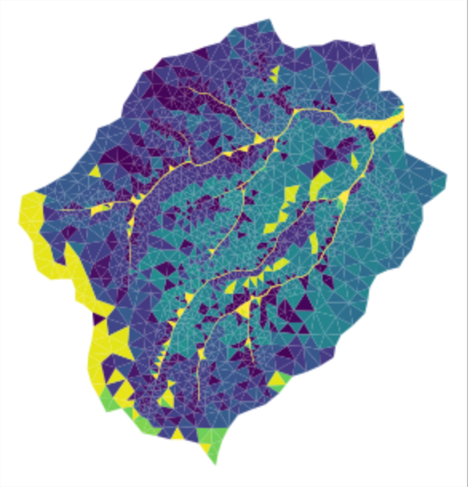
Project 4:
Watershed Workflow
Watershed Workflow is a python-based, open source chain of tools for generating meshes and other data inputs for hyper-resolution hydrology

Slide 16
Challenges
Process
Outdated documentation
Validation and Testing
Modeling and simulations
Lack of information for new/inexperienced users
Updated documentation for various operating systems and package managers
Validation of meshing and simulation results
Testing of new features
Advanced modeling and simulations
Created User Guides and Tutorials for new users

Slide 17
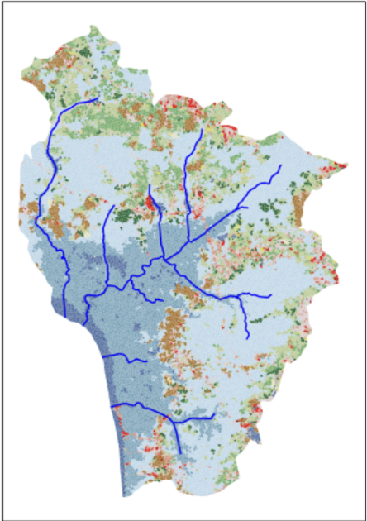
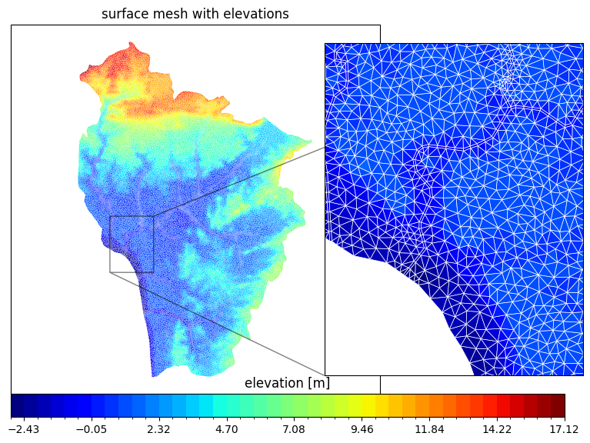
WATERSHED WORKFLOW
Results
Updated documentation for users and developers
Validated simulations and new features
Created user guides to help with new users
Images show a simulation run to help verify a new feature on Watershed Workflow. In this example I modeled a watershed on a delta. The top show the land cover of the area with the tributaries in blue, while the bottom shows the elevation of the area. The next step would be to begin running simulations on the model to analyze flow and transport in the area.

Slide 18
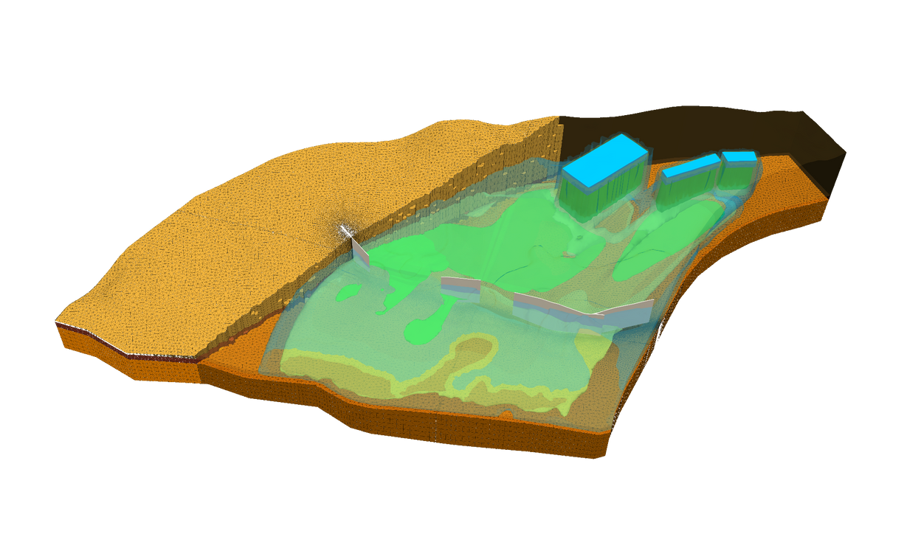
Project 5:
Amanzi/ATS
ADVANCED TERRESTRIAL SIMULATOR
Amanzi provides a flexible and extensible flow and reactive transport simulation capability for environmental applications. It features general polyhedral mesh infrastructure, which leverages MSTK, advanced discretizations of process models, including traditional finite volume schemes, mimetic finite differences, and nonlinear finite volumes.
Amanzi is applicable to groundwater contaminant migration under partially saturated, nonisothermal conditions and its interaction with surface water. The code is parallel and leverages open-source parallel frameworks such as Trilinos, PETSc.

Slide 19
Challenges
Process
Streamlined and updated installation process to use modern tools and packages and simple scripts to set environmental variables
Updated necessary dependences to prevent incompatibilities
Verified new installation on Linux, Mac (M-chip and Intel) and Windows, as well as using Homebrew and Macports. Created a guide for each to walk new users through the process if the want a local install
Updated documentation as well as documentation website using sphinx and a series of makefiles and scripts
Created tutorials, documents, and seminars for new users
Updated docker containers with a Conda environment, Jupyter notebook, and necessary dependencies to help new users get started quickly
Updated docker build scripts that are automatically run for pushes to master branch on GitHub
Complicated Installation process
Outdated and missing dependencies
Operating System issues
Outdated documentation
Lack of information for new/inexperienced users
Outdated docker container and scripts

Slide 20
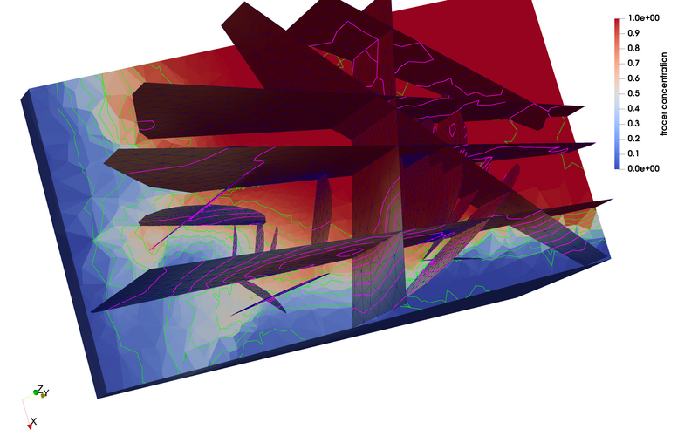
AMANZI/ATS
Results
Streamlined the installation process and updated dependencies to help simplify the difficult local build process
Tested and verified installations on multiple architectures and build systems so that support could be given to users when issues arise
Updated documentation on the website using sphinx as well as a series of scripts to make it easier on users and developers to find information
Created tutorials and seminars to aid users in learning to use the features
Created a series of docker containers and scripts to help automate environment creation, and enable users to have a consistent environment to work from
Image shows flow and transport across a fractured matrix
Notes:
This process has created a basis for enhanced user experiences and functionality.

Slide 21
Proven success in LANL code modernization
Strong foundation in DevOps, Gitlab, CI/CL, Docker, scripting, and automation
Experienced with Auto-Generated documentation and user guides
Experienced with Docker container creation, management, provisioning, and running
Unique background that combines mechanical engineering, material science, computers and software
Experience as a Linux server administrator (Ubuntu and RHEL)
POTENTIAL
Contributions to E13

Slide 22
Website Examples
LaGriT:
https://lanl.github.io/LaGriT/
dfnWorks:
https://lanl.github.io/dfnWorks/intro.html
FEHM:
https://lanl.github.io/FEHM/
Amanzi/ATS
https://amanzi.github.io/
Ideas-Watershed
https://ideas-watersheds.github.io/
Questions?
Main Mentor Contact:
Jeffrey Hyman
jhyman@lanl.gov
Mentor/Group Leader Contact:
David Moulton
moulton@lanl.gov
GitHub Code Examples
https://github.com/ehinrichs/e13

